Slide 1
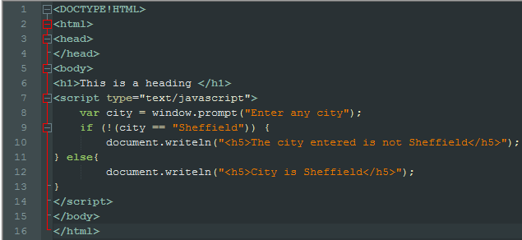
This will compare the reply to the prompt against a string to see if the reply is the same as the given string. The exclamation mark is there to see if the reply to the prompt is not the same as the given string
This will collect some information and remember it under the variable “city.” the information it will remember is based upon what is typed in as a reply to the prompt
Writeln will put whatever string or number you put into it, into your website either as whatever tag you give it, or as a paragraph
The else statement will look at the opposite of the if statement and if the entered reply to the prompt fits the opposite criteria, it will print whatever code is within the else statement.

